Slide 1
Introduction to Wireless Networking
Wireless Networking
Lecture 1

Slide 2
References
Schiller, J.H. (2003), Mobile Communications, Second Chapter 1: Introduction
Price, R. (2006), Fundamentals of Wireless Networking. Chapter 1: Introduction to Wireless Networks

Slide 3
Future Computing Devices
Computers are integrated (small, cheap, portable, replaceable - no more separate devices)
Computer are aware of their environment and adapt (“location awareness”)
Computer recognise the location of the user and react appropriately (e.g., call forwarding, fax forwarding, “context awareness”))

Slide 4
Technological Advances
Advances in technology
more computing power in smaller devices
flat, lightweight displays with low power consumption
new user interfaces due to small dimensions
more bandwidth
multiple wireless interfaces: wireless LANs, wireless WANs, regional wireless telecommunication networks etc.

Slide 5
Mobility
Two aspects of mobility:
user mobility: users communicate (wireless) “anytime, anywhere, with anyone”
device portability: devices can be connected anytime, anywhere to the network

Slide 6
Integration of Wireless Networks
Wireless vs. Mobile Examples ✗ ✗ stationary computer ✗ ✓ notebook in a hotel ✓ ✗ wireless LANs in historic buildings ✓ ✓ Personal Digital Assistant (PDA)
The demand for mobile communication creates the need for integration of wireless networks into existing fixed networks:
local area networks: standardisation of IEEE 802.11
Internet: Mobile IP extension of the internet protocol IP
wide area networks: e.g., internetworking of GSM and ISDN, VoIP over WLAN and POTS

Slide 7
Applications
Vehicles
transmission of news, road condition, weather, music via DAB/DVB-T
personal communication using GSM/UMTS
position via GPS
local ad-hoc network with vehicles close-by to prevent accidents, guidance system, redundancy
vehicle data (e.g., from buses, high-speed trains) can be transmitted in advance for maintenance

Slide 8
Applications
Emergencies
early transmission of patient data to the hospital, current status, first diagnosis
replacement of a fixed infrastructure in case of earthquakes, hurricanes, fire etc.
crisis, war, ...

Slide 9
Typical Application: Road traffic
UMTS, WLAN,
DAB, DVB, GSM,
cdma2000, TETRA, ...
ad hoc
Personal Travel Assistant,
PDA, Laptop,
GSM, UMTS, WLAN,
Bluetooth, ...

Slide 10
Mobile and Wireless Services
UMTS, GSM
115 kbit/s
LAN
100 Mbit/s,
WLAN
54 Mbit/s
DSL/ WLAN
3 Mbit/s
GSM/GPRS 53 kbit/s
Bluetooth 500 kbit/s
UMTS
2 Mbit/s
GSM/EDGE 384 kbit/s,
DSL/WLAN 3 Mbit/s
UMTS, GSM
384 kbit/s
GSM 115 kbit/s,
WLAN 11 Mbit/s

Slide 11
More Applications
Travelling salesmen
direct access to customer files stored in a central location
consistent databases for all agents
mobile office
Replacement of fixed networks
remote sensors, e.g., weather, earth activities
flexibility for trade shows
LANs in historic buildings
Entertainment, education, ...
outdoor Internet access
intelligent travel guide with up-to-date location dependent information
ad-hoc networks for multi user games
History
Info

Slide 12
Location dependent services
Location aware services
what services, e.g., printer, fax, phone, server etc. exist in the local environment
Follow-on services
automatic call-forwarding, transmission of the actual workspace to the current location
Information services
“push”: e.g., current special offers in the supermarket
“pull”: e.g., where is the Black Forrest Cheese Cake?
Support services
caches, intermediate results, state information etc. “follow” the mobile device through the fixed network
Privacy
who should gain knowledge about the location

Slide 13
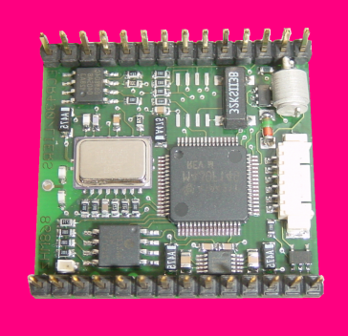

Mobile devices
Laptop/Notebook
fully functional
standard applications
Pager
receive only
tiny displays
simple text messages
PDA
graphical displays
character recognition
simplified WWW
Sensors,
embedded
controllers
Smartphone
tiny keyboard
simple versions of standard applications
Mobile phones
voice, data
simple graphical displays
www.scatterweb.net
performance
No clear separation between device types possible
(e.g. smart phones, embedded PCs, …)

Slide 14
Effects of device portability
Power consumption
limited computing power, low quality displays, small disks due to limited battery capacity
Loss of data
higher probability, has to be included in advance into the design (e.g., defects, theft)
Limited user interfaces
compromise between size of fingers and portability
integration of character/voice recognition, abstract symbols
Limited memory
limited usage of mass memories with moving parts
flash-memory or ? as alternative

Slide 15
Wireless networks in comparison to fixed networks
Higher loss-rates due to interference
emissions of, e.g., engines, lightning
Restrictive regulations of frequencies
frequencies have to be coordinated, useful frequencies are almost all occupied
Low transmission rates
local some Mbit/s, regional currently, e.g., 53kbit/s with GSM/GPRS or about 150 kbit/s using EDGE
Higher delays, higher jitter
connection setup time with GSM in the second range, several hundred milliseconds for other wireless systems
Lower security, simpler active attacking
radio interface accessible for everyone, base station can be simulated, thus attracting calls from mobile phones
Always shared medium
secure access mechanisms important

Slide 16
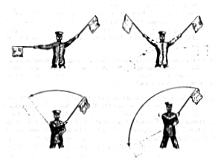
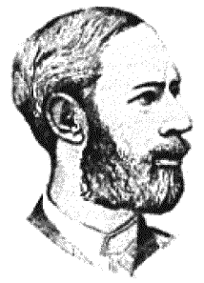
Early history of wireless communication
Many people in history used light for communication
heliographs, flags (“semaphore”), ...
150 BC smoke signals for communication; (Polybius, Greece)
1794, optical telegraph, Claude Chappe
Here electromagnetic waves are of special importance:
1831 Faraday demonstrates electromagnetic induction
J. Maxwell (1831-79): theory of electromagnetic fields, wave equations (1864)
H. Hertz (1857-94): demonstrates with an experiment the wave character of electrical transmission through space (1888, in Karlsruhe, Germany)

Slide 17
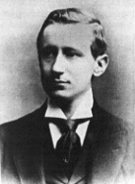
History of wireless communication I
1896 Guglielmo Marconi
first demonstration of wireless telegraphy (digital!)
long wave transmission, high transmission power necessary (> 200kW)
1907 Commercial transatlantic connections
huge base stations (30 100m high antennas)
1915 Wireless voice transmission New York - San Francisco
1920 Discovery of short waves by Marconi
reflection at the ionosphere
smaller sender and receiver, possible due to the invention of the vacuum tube (1906, Lee DeForest and Robert von Lieben)
1926 Train-phone on the line Hamburg - Berlin
wires parallel to the railroad track

Slide 18
History of wireless communication II
1928 many TV broadcast trials (across Atlantic, color TV, news)
1933 Frequency modulation (E. H. Armstrong)
1950’s Analog, connection setup only from the mobile station, no handover
1970’s analog, connection setup from the fixed network too (but location of the mobile station has to be known)
1982 Start of GSM-specification
goal: pan-European digital mobile phone system with roaming
1983 Start of the American AMPS (Advanced Mobile Phone System, analog)
1984 CT-1 standard (Europe) for cordless telephones

Slide 19
History of wireless communication III
1991 Specification of DECT
Digital European Cordless Telephone (today: Digital Enhanced Cordless Telecommunications)
1880-1900MHz, ~100-500m range, 120 duplex channels, 1.2Mbit/s data transmission, voice encryption, authentication, up to several 10000 user/km², used in more than 50 countries
1992 Start of GSM roll-out
fully digital, 900MHz, 124 channels
automatic location, hand-over, cellular
roaming in Europe - now worldwide in more than 200 countries
services: data with 9.6kbit/s, FAX, voice, ...

Slide 20
History of wireless communication IV
1996 HiperLAN (High Performance Radio Local Area Network)
ETSI, standardisation of type 1: 5.15 - 5.30GHz, 23.5Mbit/s
recommendations for type 2 and 3 (both 5GHz) and 4 (17GHz) as wireless ATM-networks (up to 155Mbit/s)
1997 Wireless LAN - IEEE802.11
IEEE standard, 2.4 - 2.5GHz and infrared, 2Mbit/s
already many (proprietary) products available in the beginning
1998 Specification of GSM successors
for UMTS (Universal Mobile Telecommunications System) as European proposals for IMT-2000
Iridium
66 satellites (+6 spare), 1.6GHz to the mobile phone

Slide 21
History of wireless communication V
1999 Standardization of additional wireless LANs
IEEE standard 802.11b, 2.4-2.5GHz, 11Mbit/s
Bluetooth for piconets, 2.4GHz, <1Mbit/s
decision about IMT-2000
several “members” of a “family”: UMTS, cdma2000, DECT, …
Start of WAP (Wireless Application Protocol) and i-mode
first step towards a unified Internet/mobile communication system
access to many services via the mobile phone
2000 GSM with higher data rates
first GPRS trials with up to 50 kbit/s (packet oriented!)
UMTS auctions/beauty contests
Hype followed by disillusionment (50 B$ paid in Germany for 6 licenses!)
Iridium goes bankrupt
2001 Start of 3G systems
Cdma2000 in Korea, UMTS tests in Europe, Foma (almost UMTS) in Japan

Slide 22
History of wireless communication VI
2002
WLAN hot-spots start to spread
2003
UMTS starts
Start of DVB-T replacing analog TV
2005
WiMax starts as DSL alternative (not mobile)
first ZigBee products
2006
HSDPA starts as fast UMTS download version offering > 3 Mbit/s
WLAN draft for 250 Mbit/s (802.11n) using MIMO
WPA2 mandatory for Wi-Fi WLAN devices
2007
over 3.3 billion subscribers for mobile phones (NOT 3 bn people!)
2008
“real” Internet widely available on mobile phones (standard browsers, decent data rates)
7.2 Mbit/s HSDPA, 1.4 Mbit/s HSUPA available in Germany, more than 100 operators support HSPA worldwide, first LTE tests (>100 Mbit/s)
2009 – the story continues with netbooks, iphones, VoIPoWLAN…

Slide 23
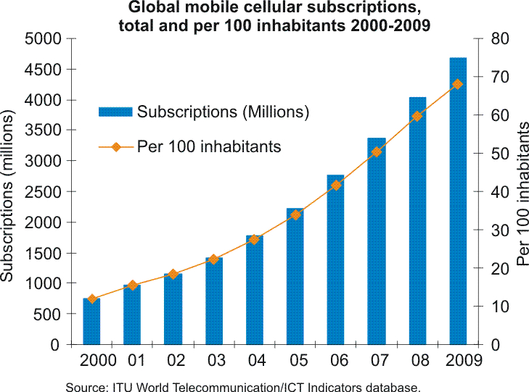
Mobile Subscriptions Worldwide

Slide 24
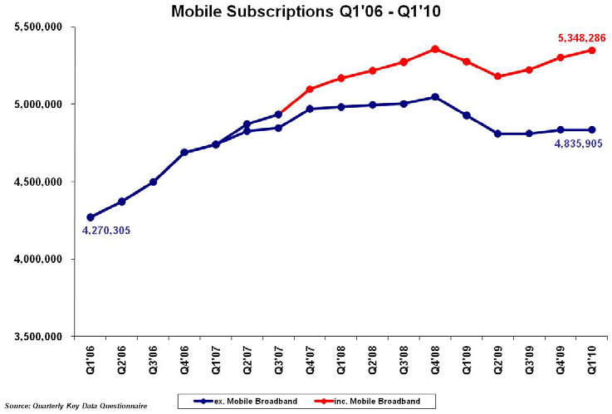
Mobile Subscriptions (Ireland)

Slide 25
Overlay Networks - the global goal
integration of heterogeneous fixed and mobile networks with varying transmission characteristics
regional
vertical
handover
metropolitan area
campus-based
horizontal
handover
in-house

Slide 26
Areas of research in mobile communication
Wireless Communication
transmission quality (bandwidth, error rate, delay)
modulation, coding, interference
media access, regulations
...
Mobility
location dependent services
location transparency
quality of service support (delay, jitter, security)
...
Portability
power consumption
limited computing power, sizes of display, ...
usability
...

Slide 27
Reference Model
Application
Application
Transport
Transport
Network
Network
Network
Network
Data Link
Data Link
Data Link
Data Link
Physical
Physical
Physical
Physical
Radio
Medium

Slide 28
Functions of Layers
Application layer
Transport layer
Network layer
Data link layer
Physical layer
service location
new/adaptive applications
multimedia
congestion/flow control
quality of service
addressing, routing
device location
hand-over
authentication
media access/control
multiplexing
encryption
modulation
interference
attenuation
frequency

